Slide 1
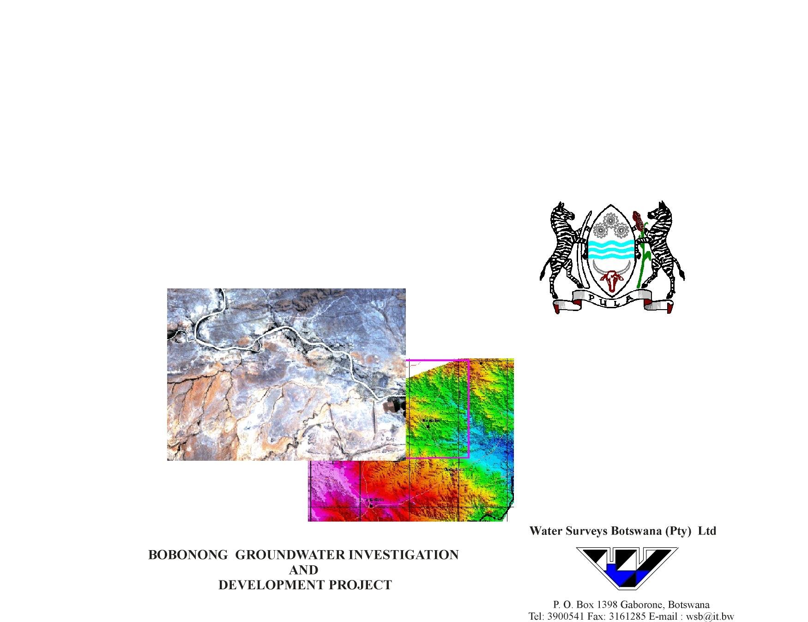
Department of Water Affairs
Bobonong Groundwater Investigation

Slide 2
Introduction
T. Preston

Slide 3
Project Objectives
Locate and Drill 41 Exploration/Production Boreholes to:
  Establish the presence and aquifer properties of the Tsheung Sandstone
  Alleviate water supply problems in villages in and around the Project Area
  Meet 2031 projected water demand of 6654m3/day
Notes:
Plus 7 monitoring boreholes (5 at Thune Dam & 2 on Shashe River

Slide 4
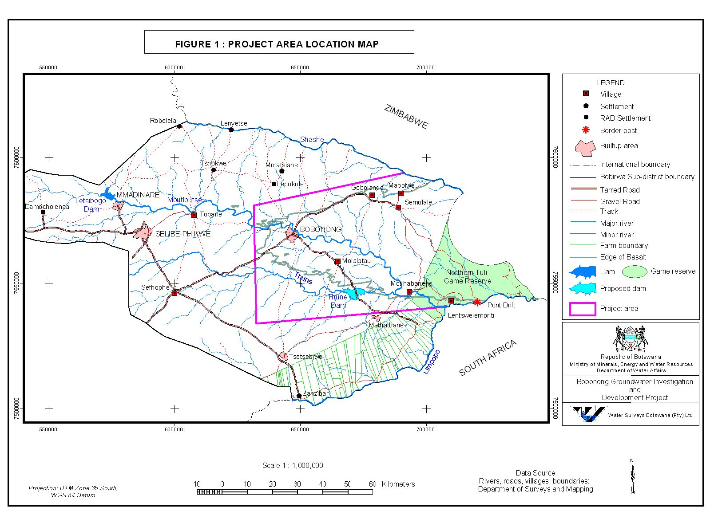

Slide 5
Supply Villages
Bobonong
Damochojena
Gobojango
Lentswelemoriti
Molalatau
Moletemane
Motlhabaneng
Mabolwe
Mathathane
Robelela
Sefhophe
Semolale
Tobane
Tsetsejwe
Tshokwe

Slide 6
Long Term Supply Concept
Conjunctive Use
To develop wellfields to be used as standby supplies in times of drought i.e. when water levels are low in Thuni Dam which is currently under construction

Slide 7
Physiography
T. Preston

Slide 8
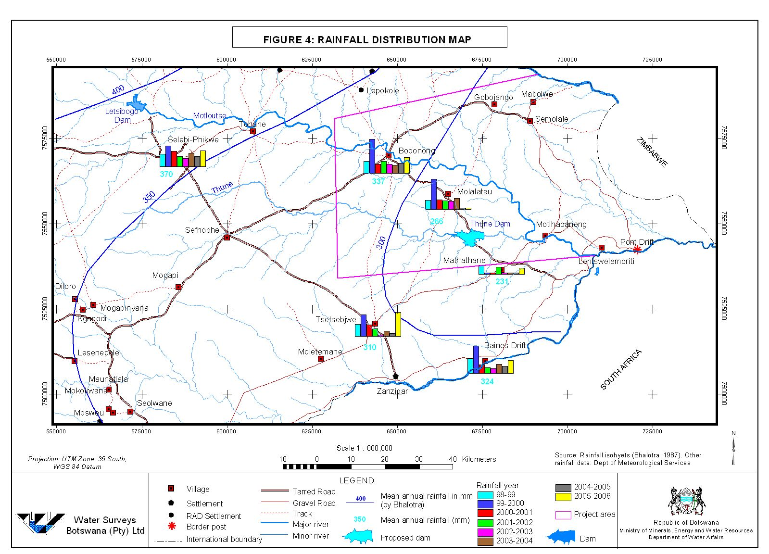

Slide 9
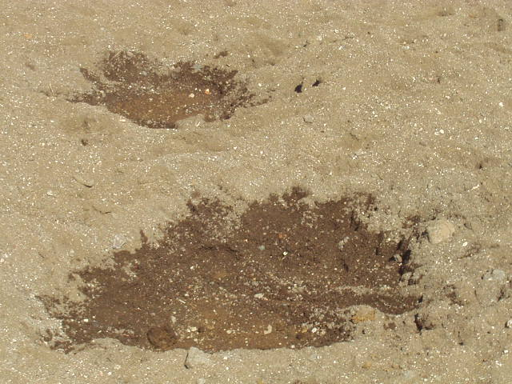

Slide 10
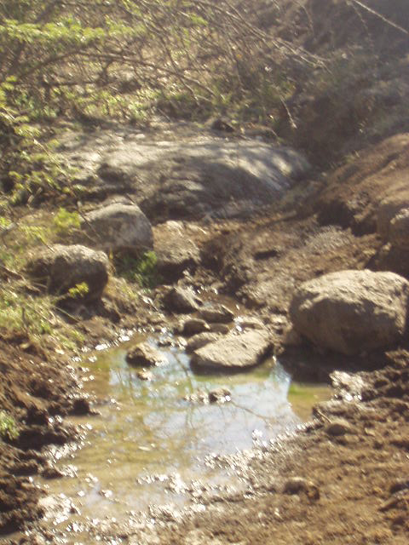

Slide 11
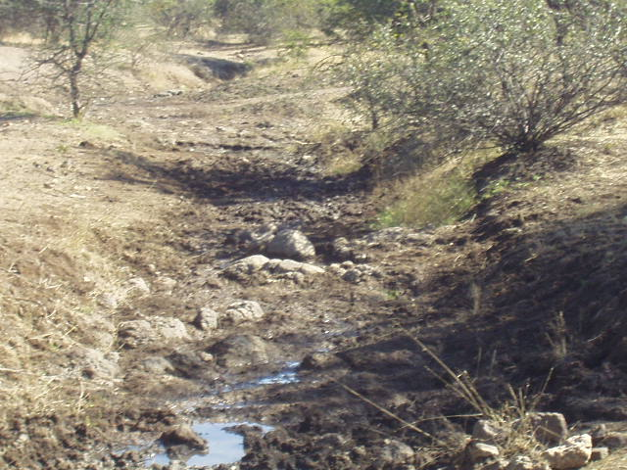

Slide 12
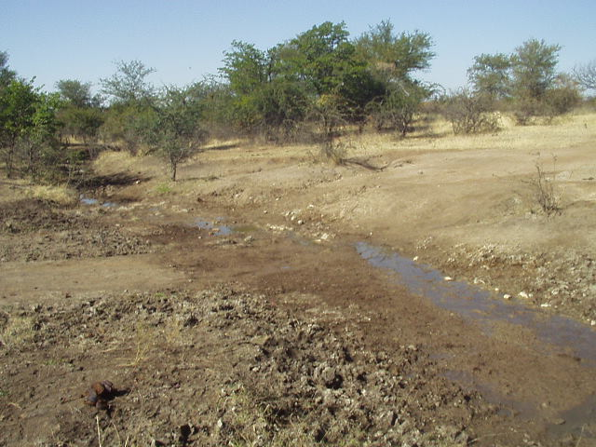

Slide 13
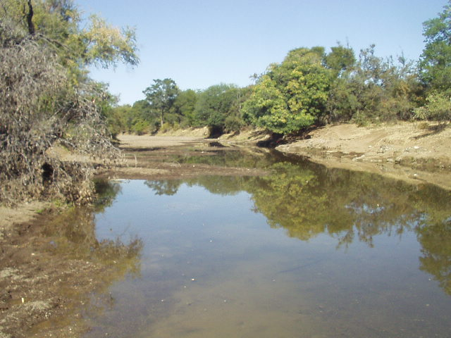

Slide 14
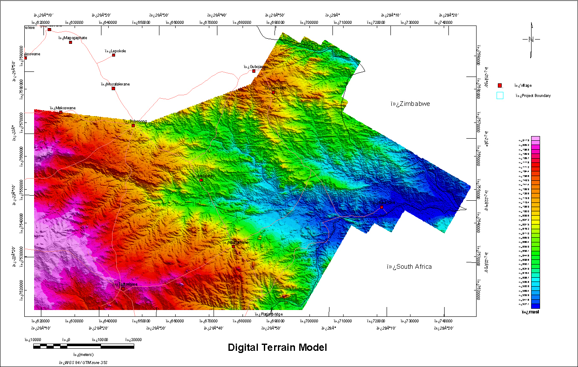

Slide 15
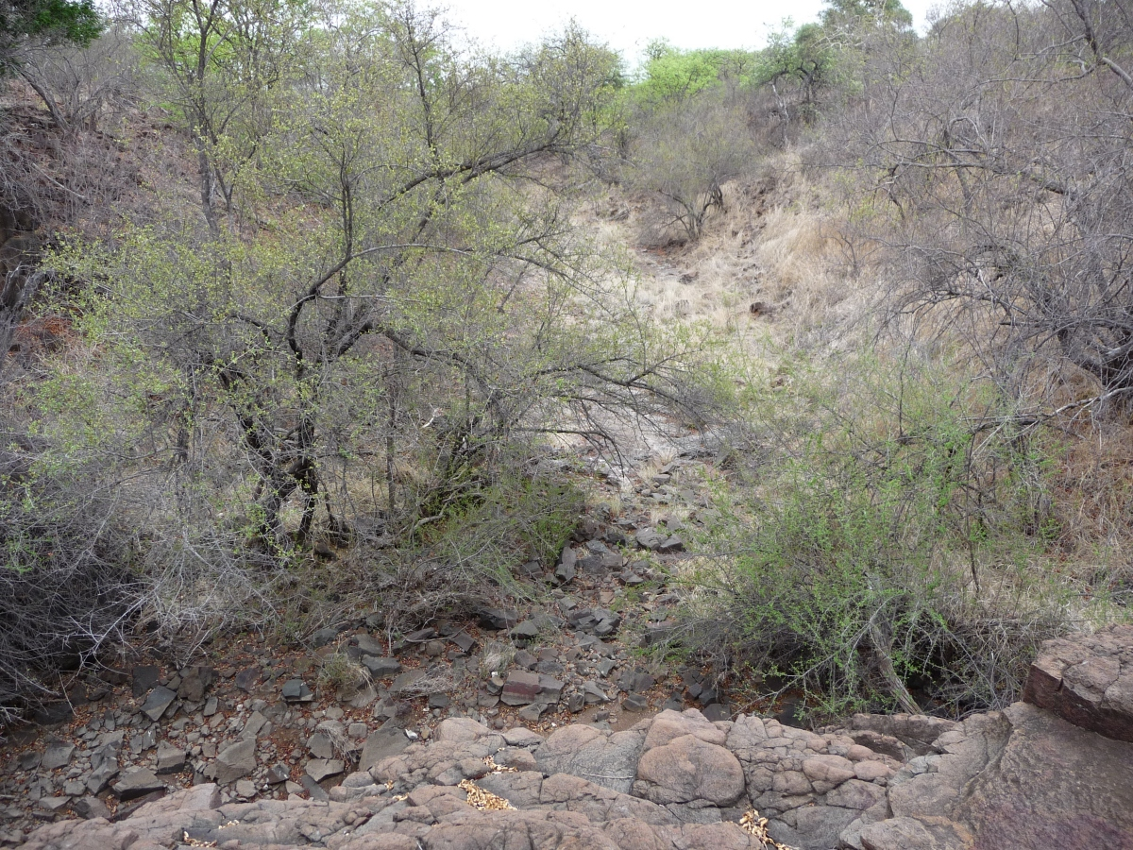

Slide 16
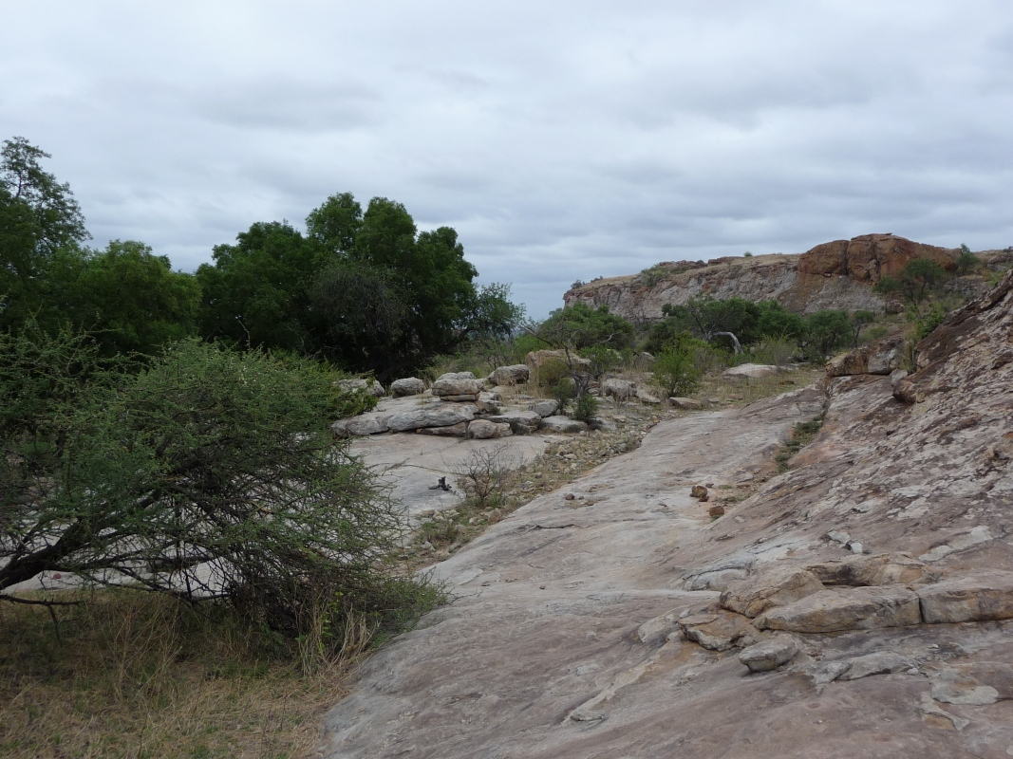

Slide 17
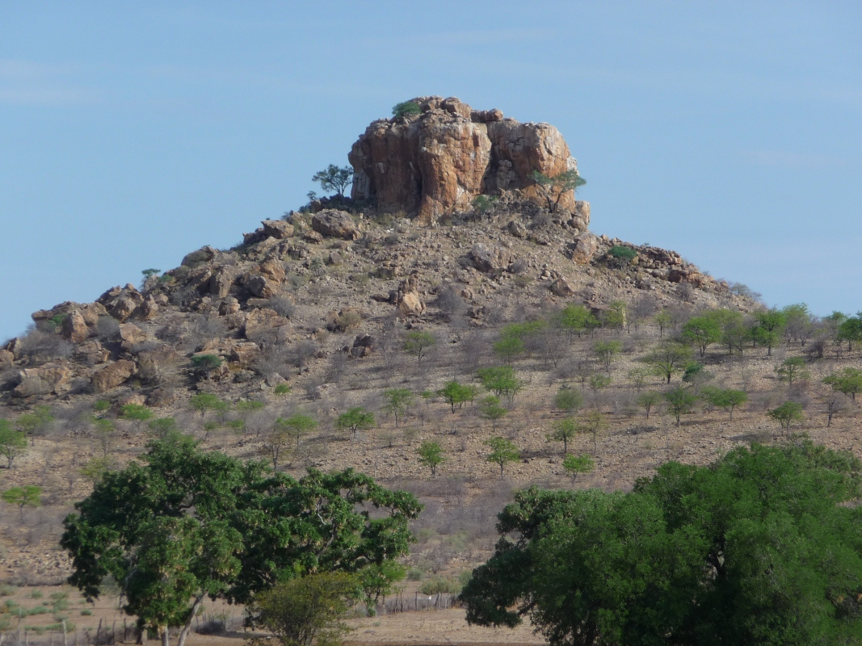

Slide 18
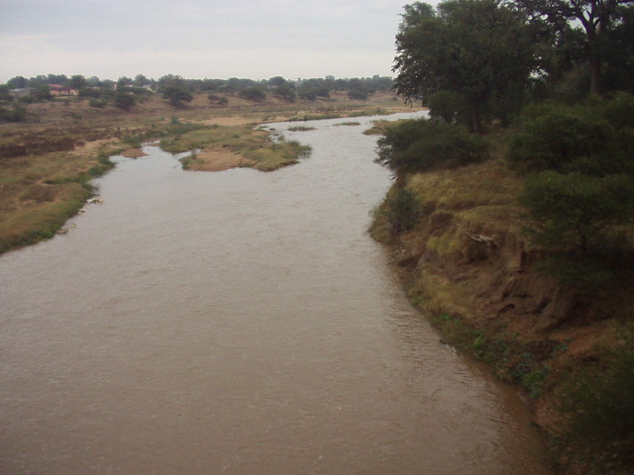

Slide 19
Water Demand & Supplies
T. Preston

Slide 20
Village
Year 2021 Water Demand (m³/d)
1.
Bobonong
3,648
2.
Gobojango
53
3.
Lentswelemoriti
15
4.
Molalatau
74
5.
Moletemane
28
6.
Motlhabaneng
28
7.
Mabolwe
24
8.
Mathathane
79
9
Semolale
42
10.
Tsetsebjwe
605
Total
4,596

Slide 21
Existing Supply Clusters
Bobonong Wellfield comprising four boreholes (BH8554; 8634; 8635 & the old road's borehole 2BB) supplying Bobonong and its associated localities.
Bobonong Wellfield comprising BH’s 8552 & 8553 supplying Molalatau and its associated localities.
Motlhabaneng (BH’s 9513; 9514 & 9515) supplying Mathathane and Tsetsebjwe. With BH 8700 supplying Motlhabaneng independently.
Gobojango (BH’s 3605; 4726; 5726; 7636 & 8585) supplying Gobojango, Semolale & Mabolwe.

Slide 22
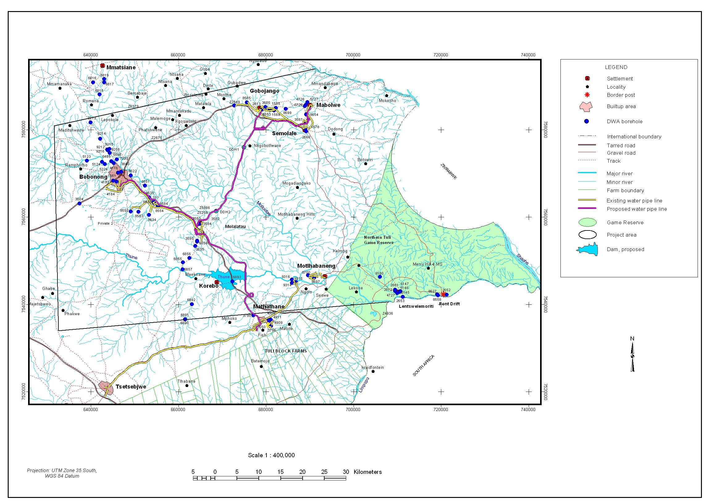

Slide 23
Existing Supplies & Shortfall
Bobonong Wellfield – Average Output 2771m3/day
Shortfall in Projected 2031 Demand 3883m3/day

Slide 24
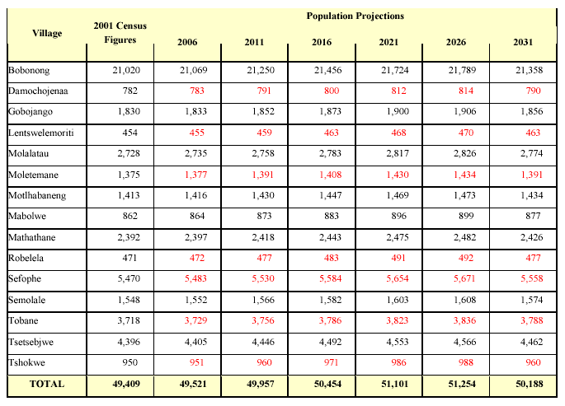

Slide 25
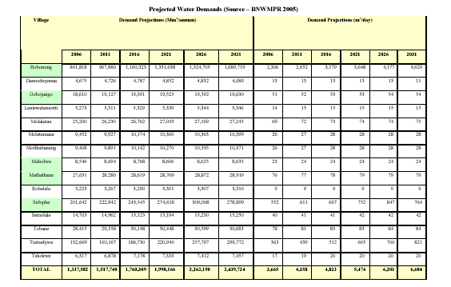

Slide 26
Concerns
Nearly all existing production boreholes are pumped for 24 hours daily*
Telemetric system for Bobonong Wellfield does not & never has worked
Losses appear to be very high >50% in some localities
Recorded daily & monthly pumping rates far exceed calculated water demand
Notes:
*This will cause borehole failure (already happened at Bobonong & Motlhabeneng) other borehole records show “pump intake reached”

Slide 27
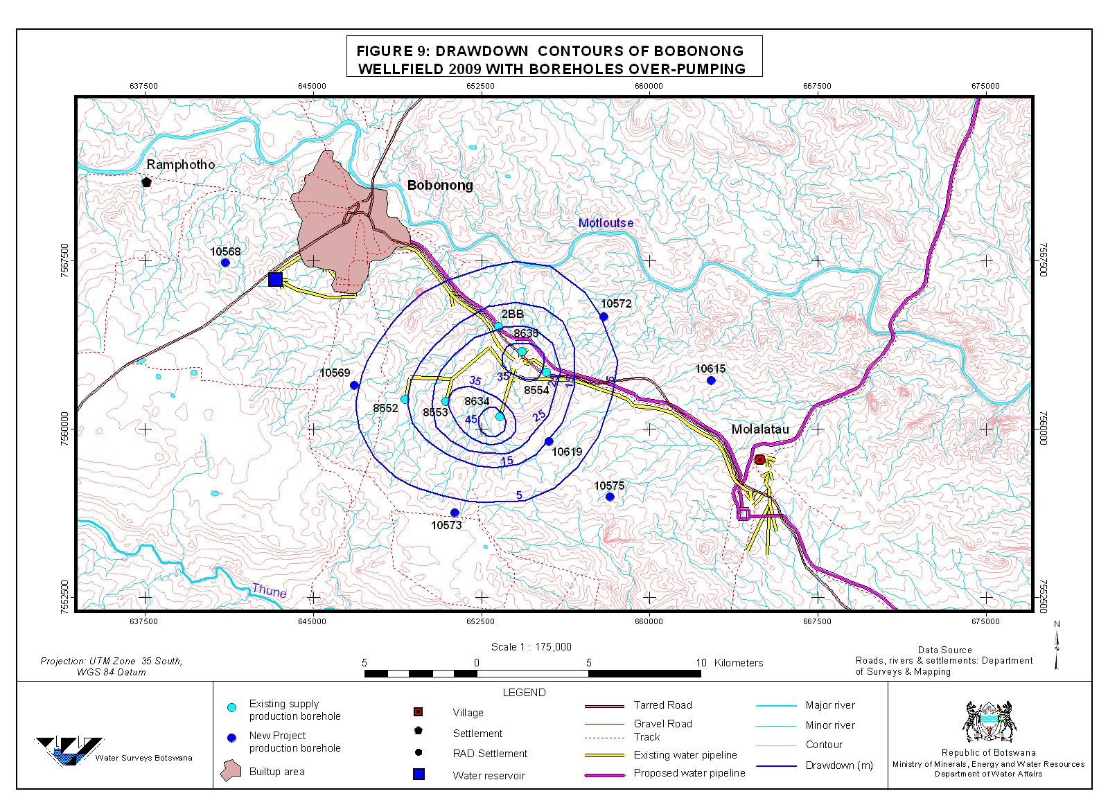
Impact of Over pumping

Slide 28
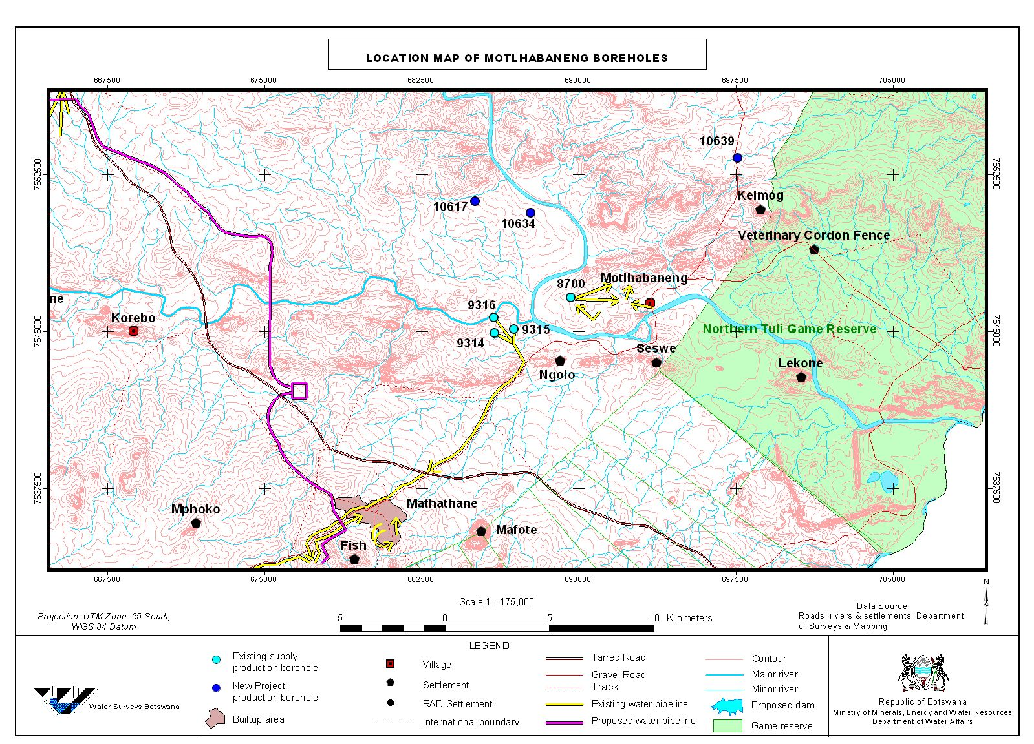

Slide 29
Remote Sensing Study
T. Preston

Slide 30
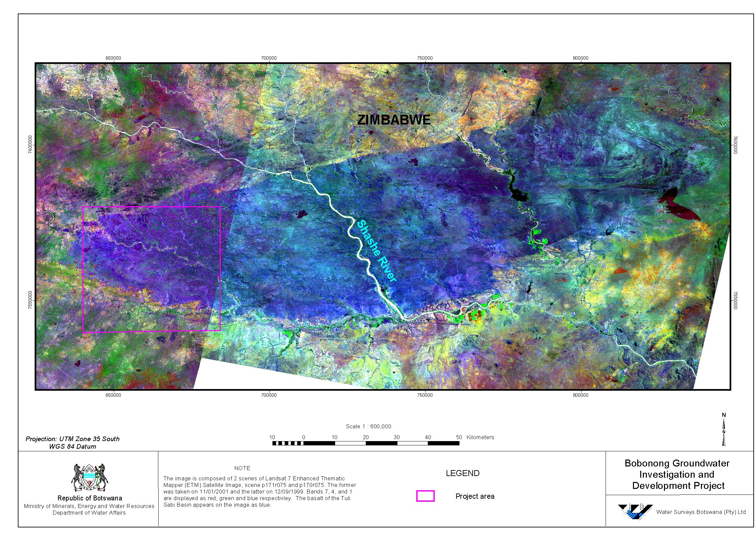

Slide 31
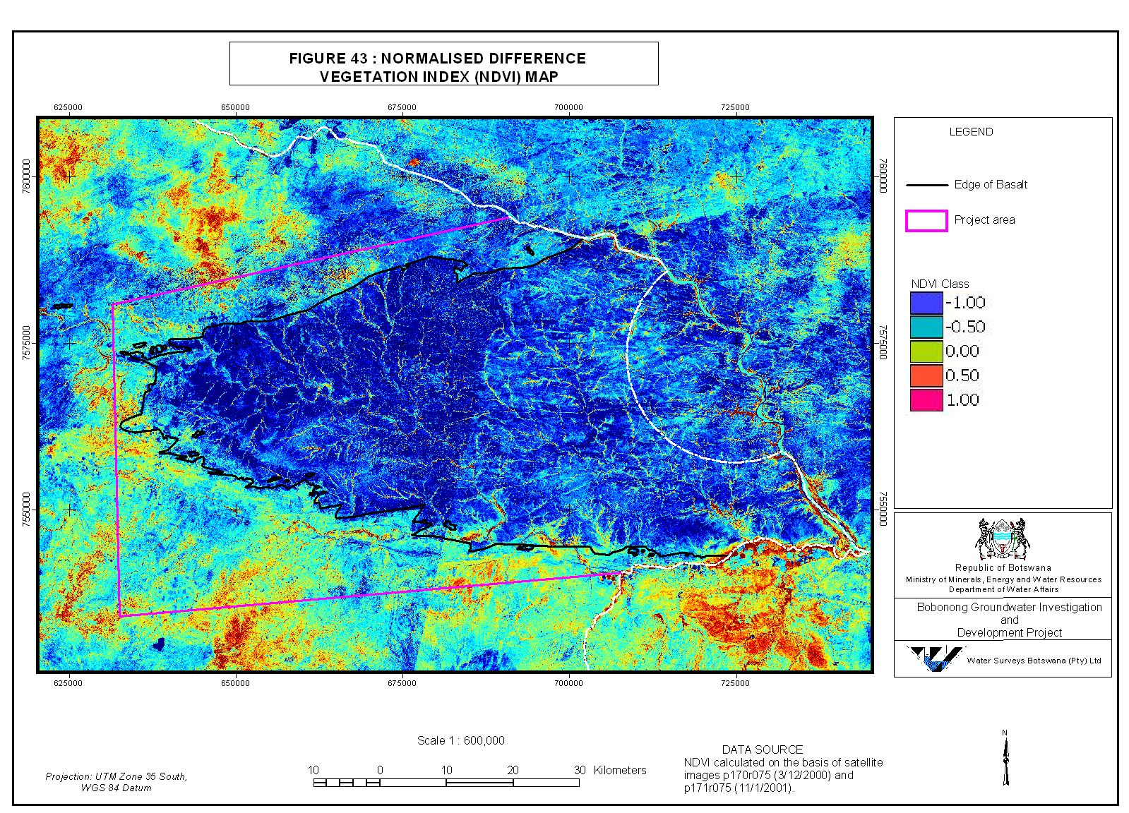

Slide 32
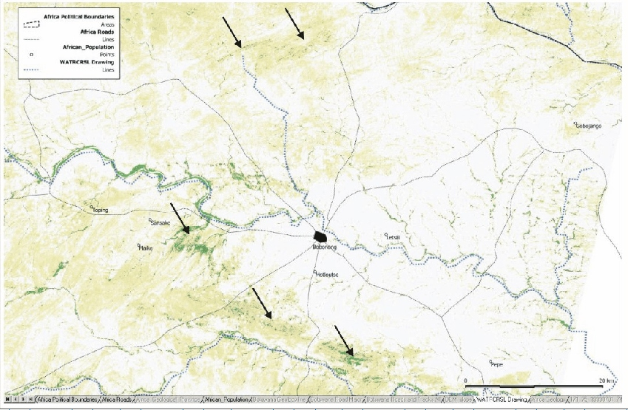

Slide 33
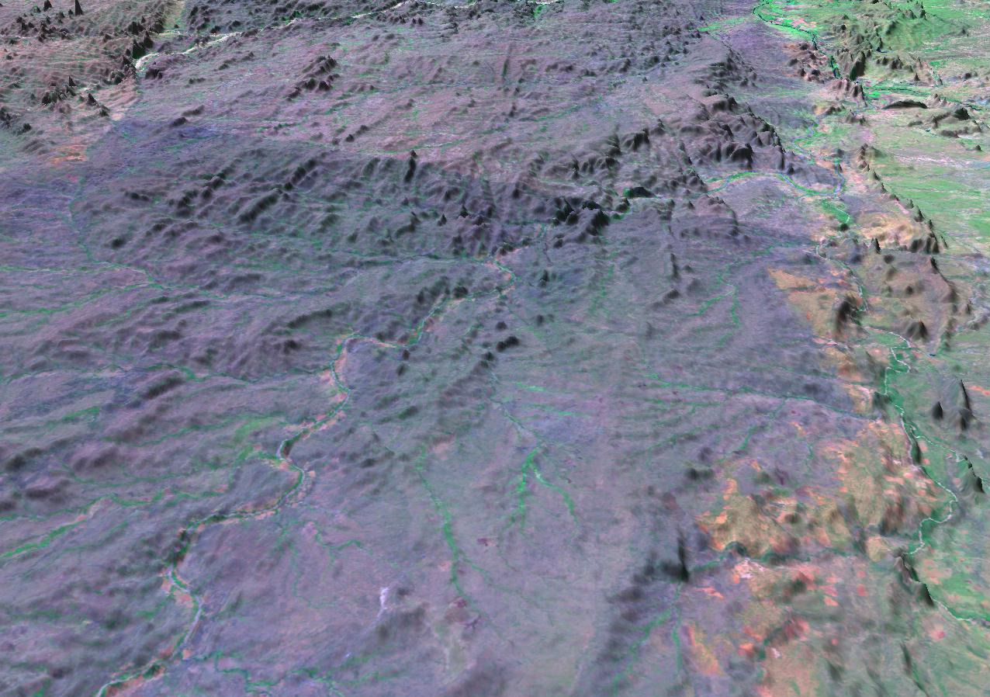

Slide 34
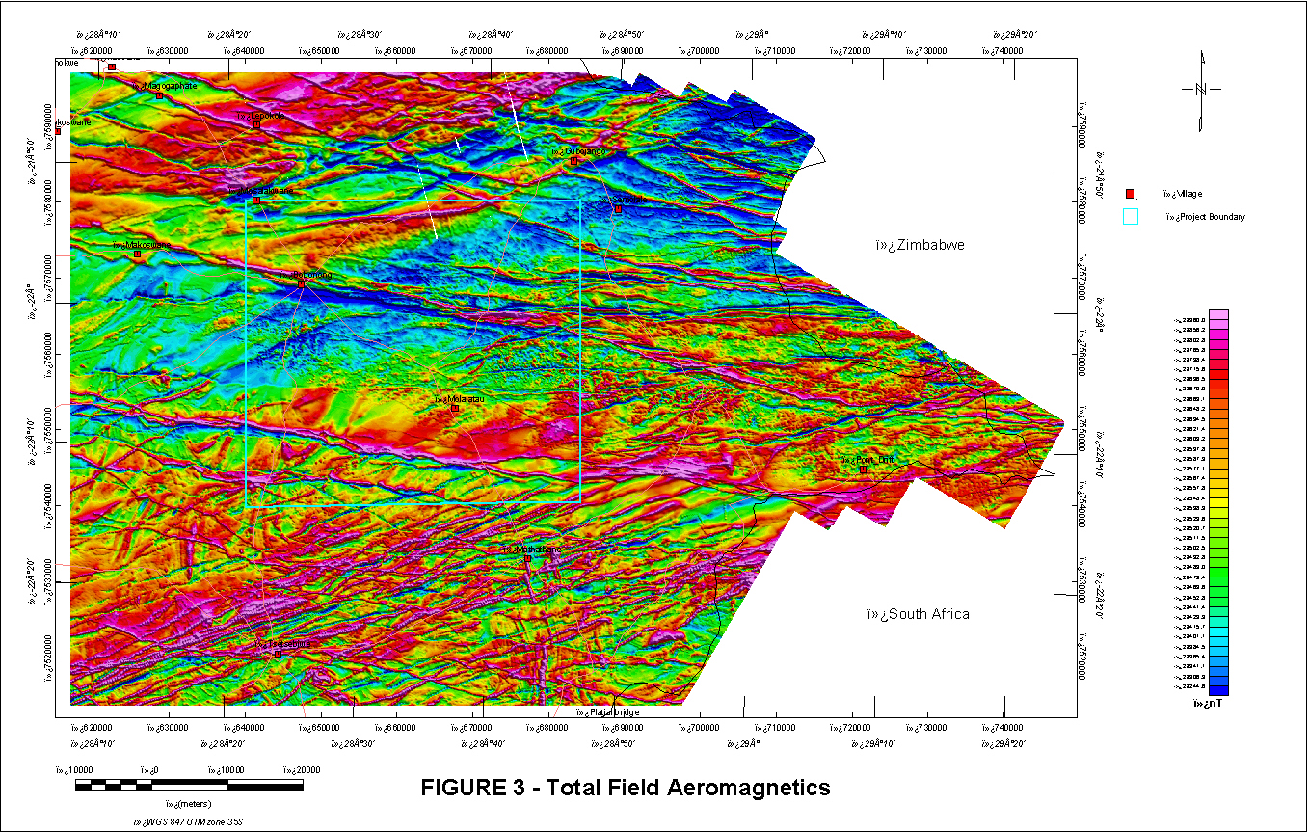

Slide 35
Modelled Aeromagnetic Profile 2 from Molalatau through Bobonong

Slide 36
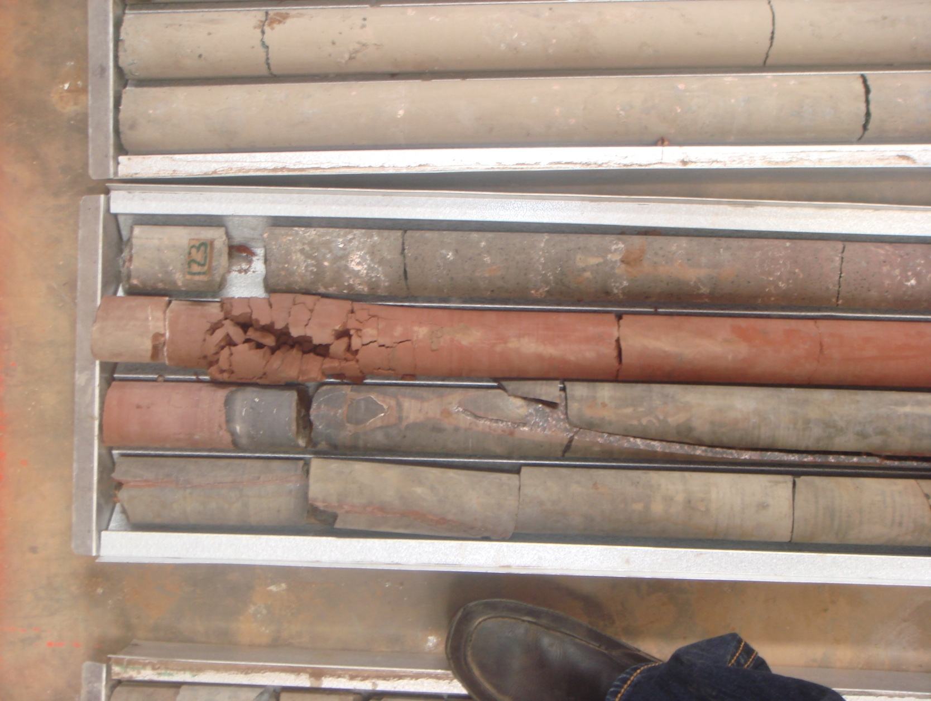

Slide 37
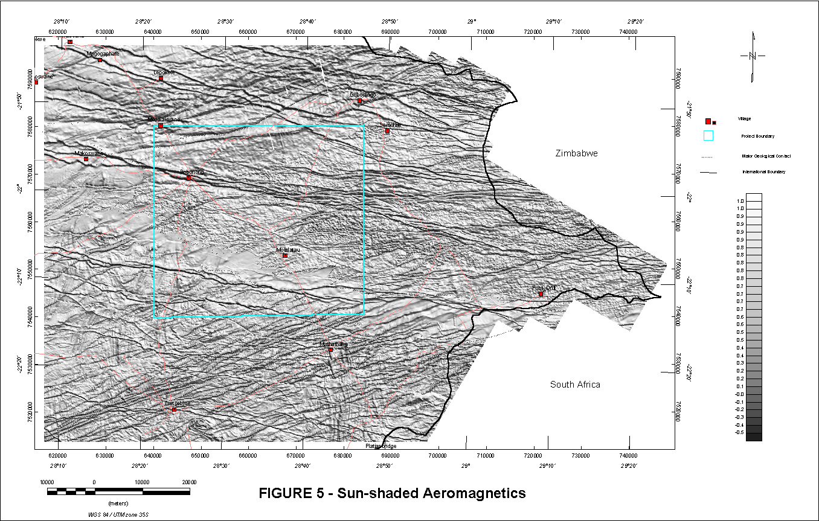

Slide 38
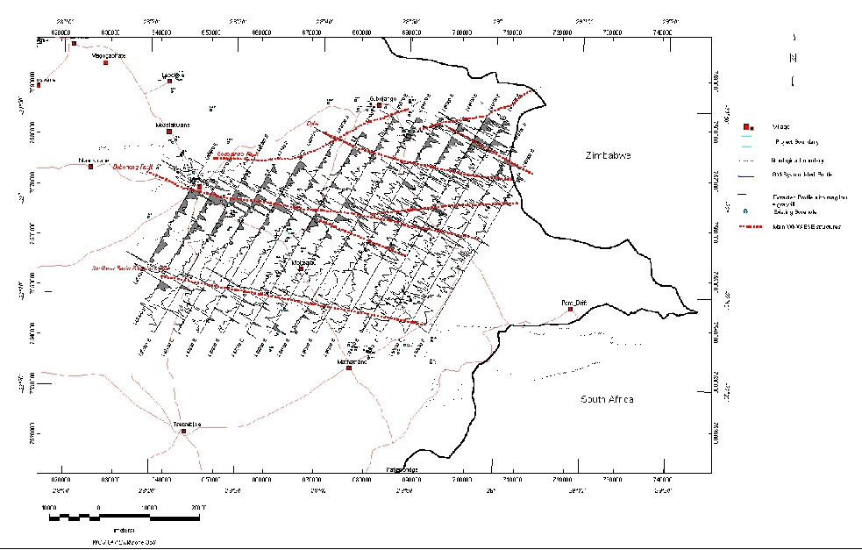

Slide 39
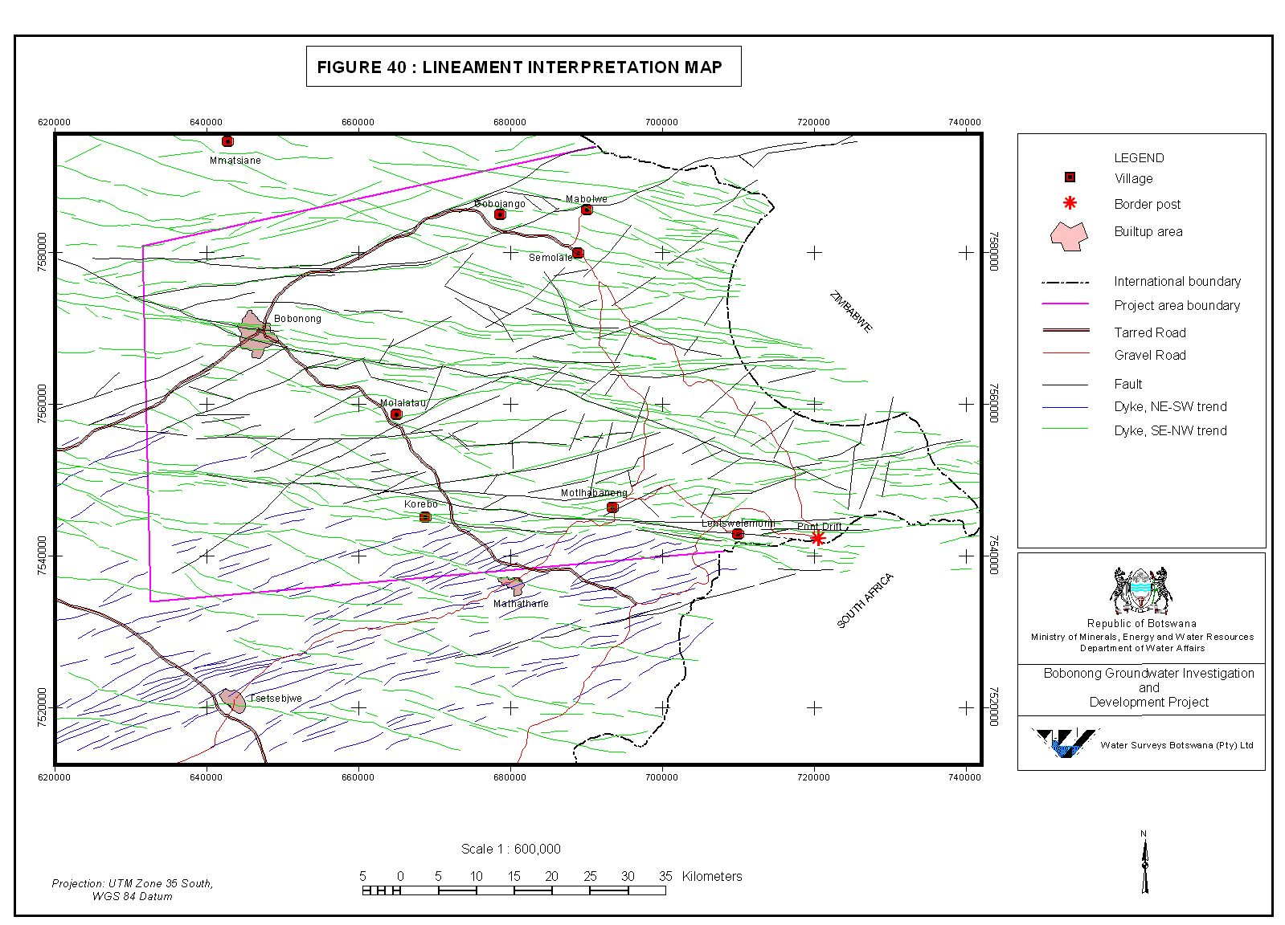

Slide 40
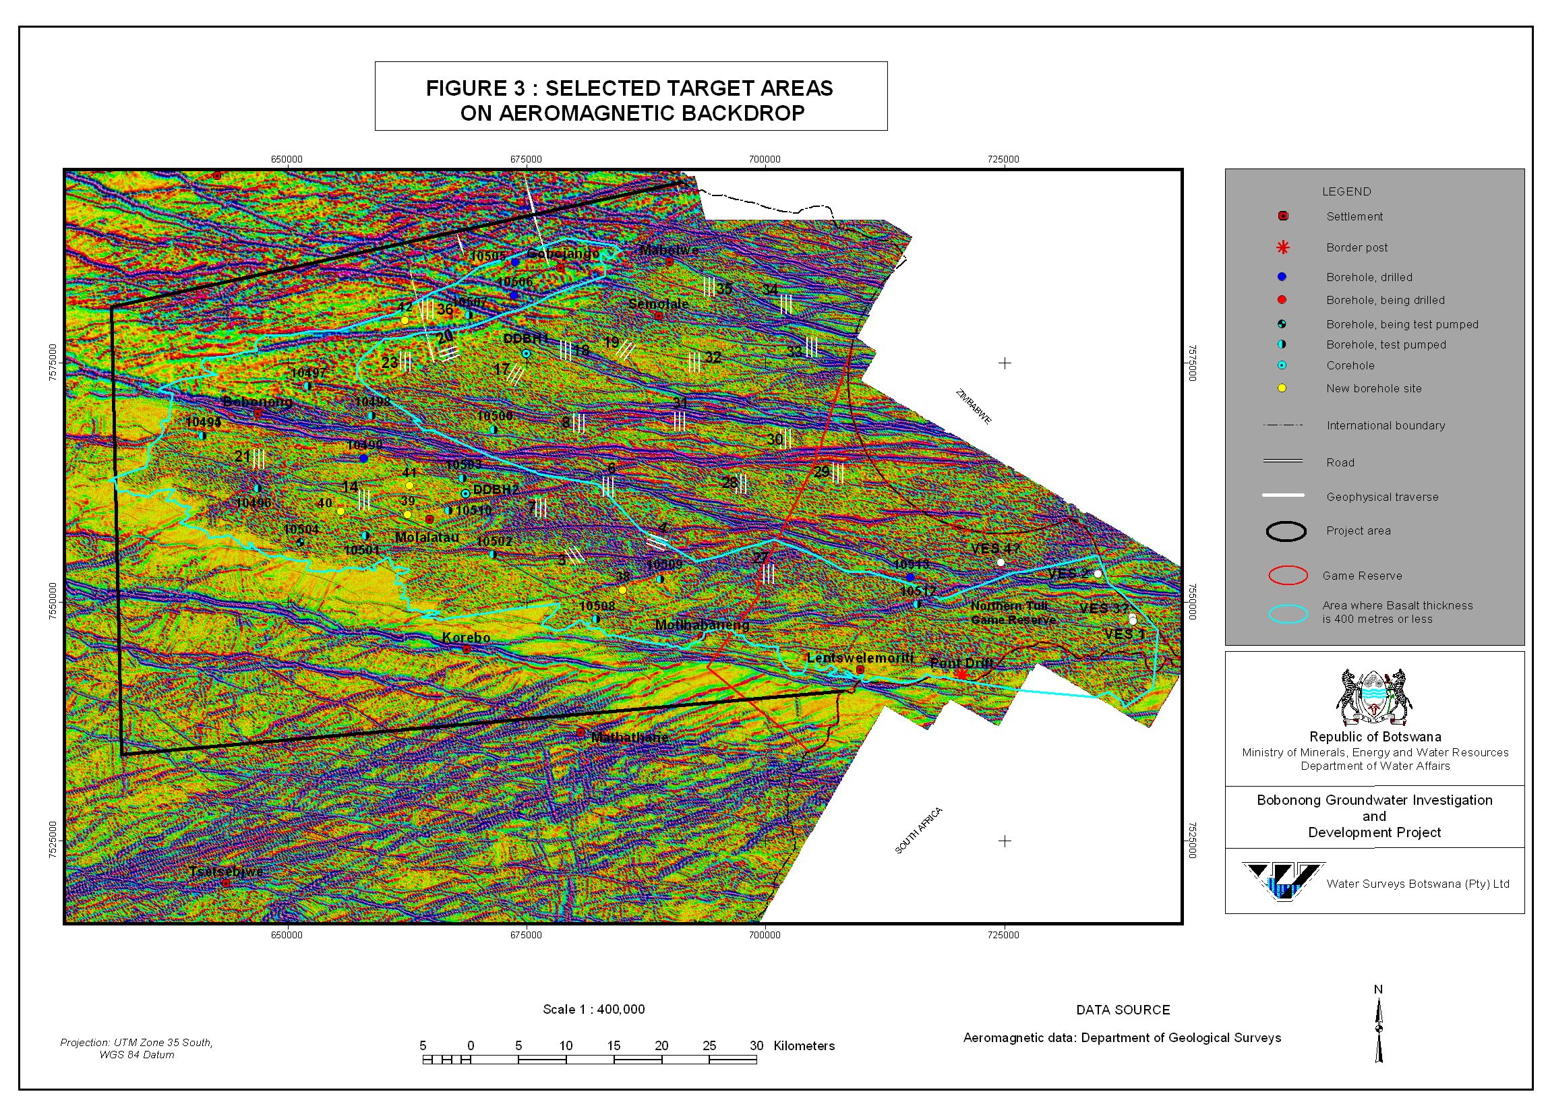

Slide 41
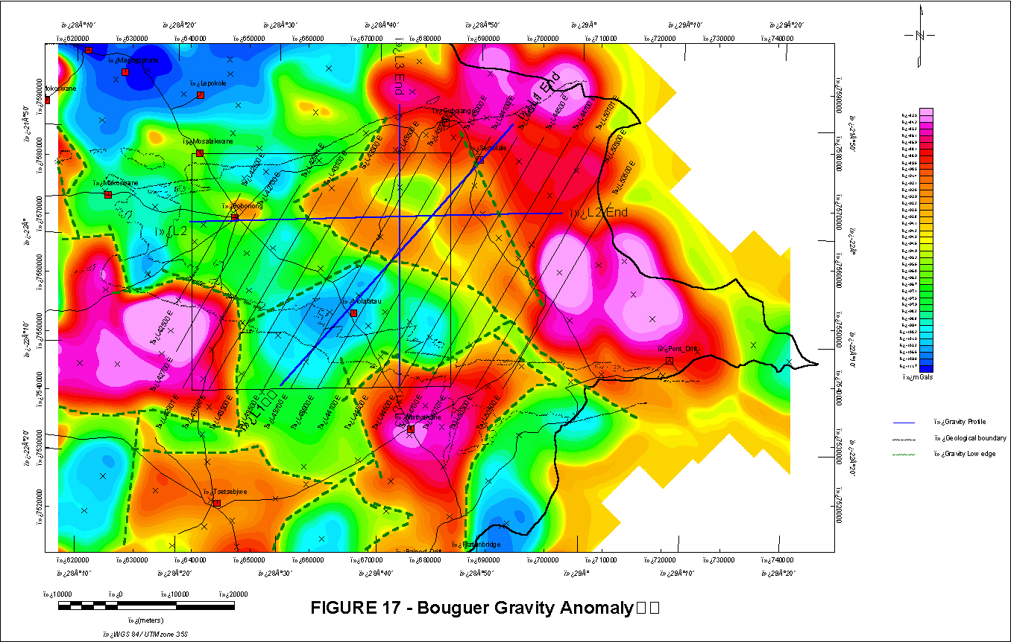

Slide 42
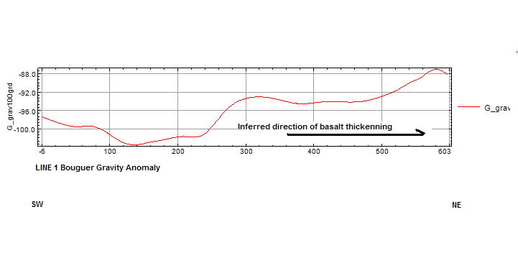
Modelled Gravity Profile

Slide 43
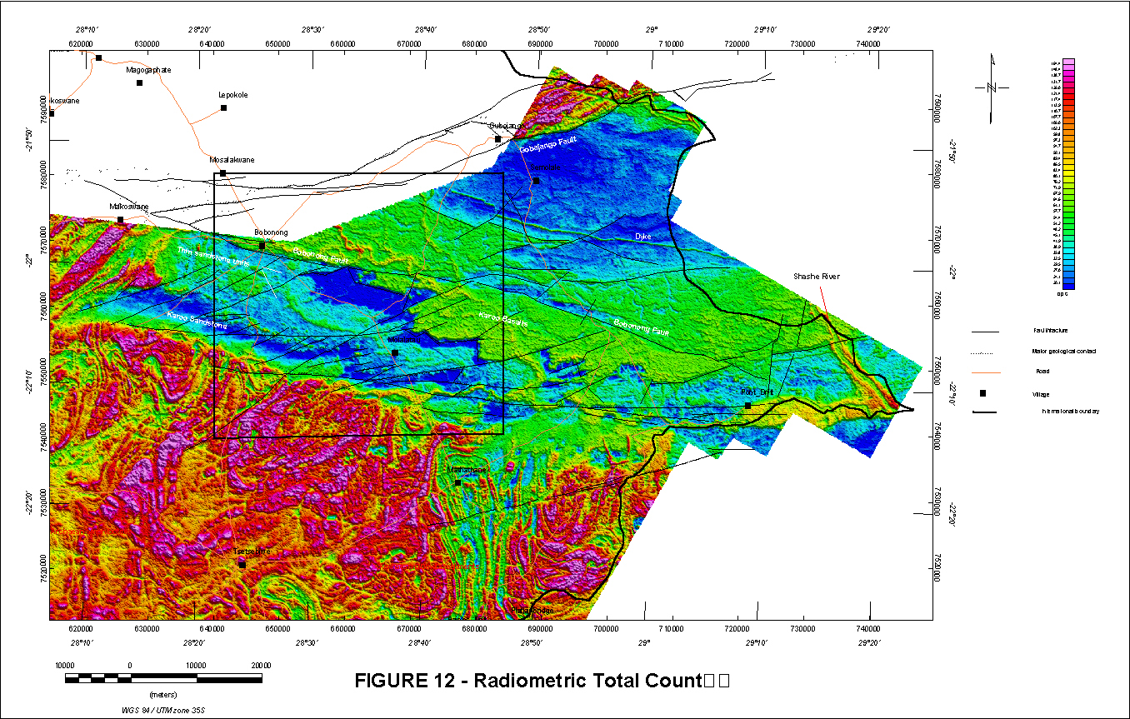

Slide 44
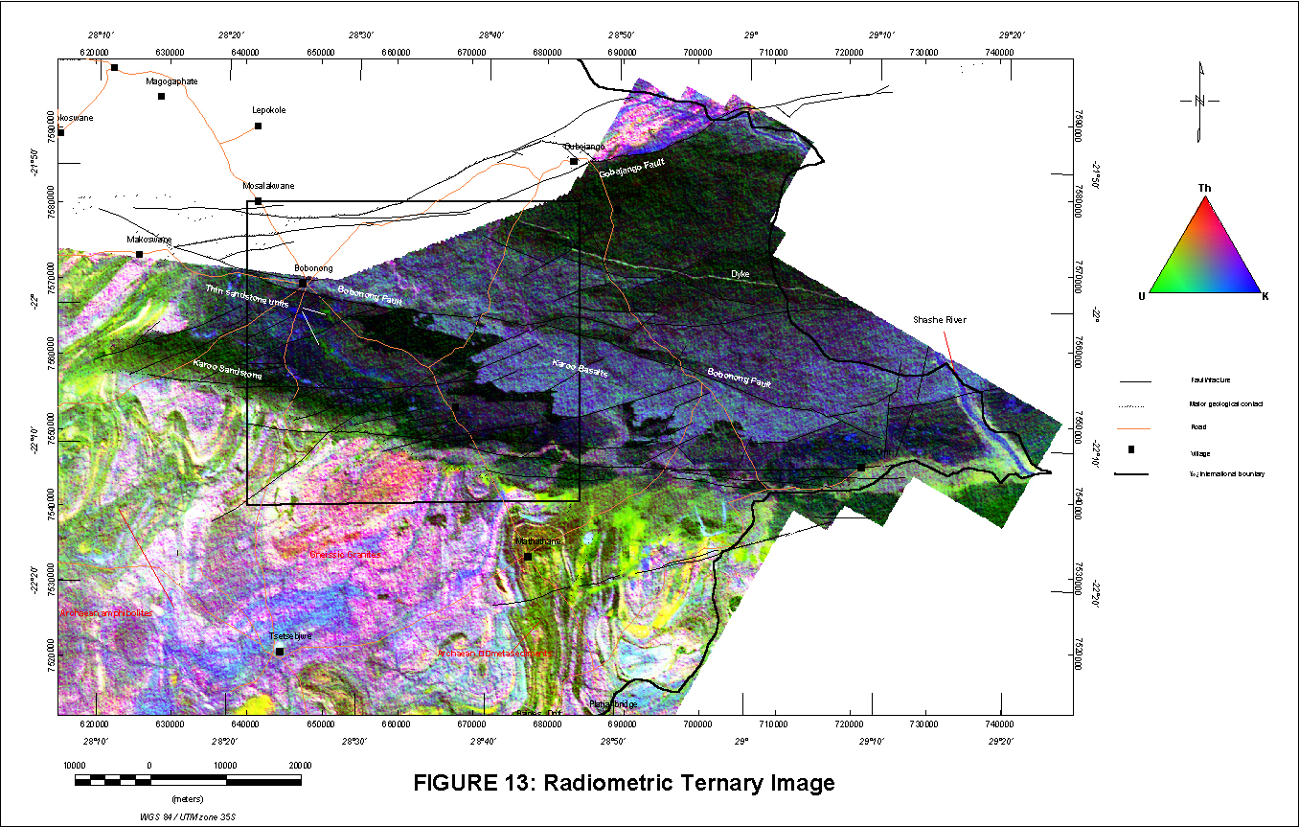

Slide 45
Geology Study
T. Preston

Slide 46
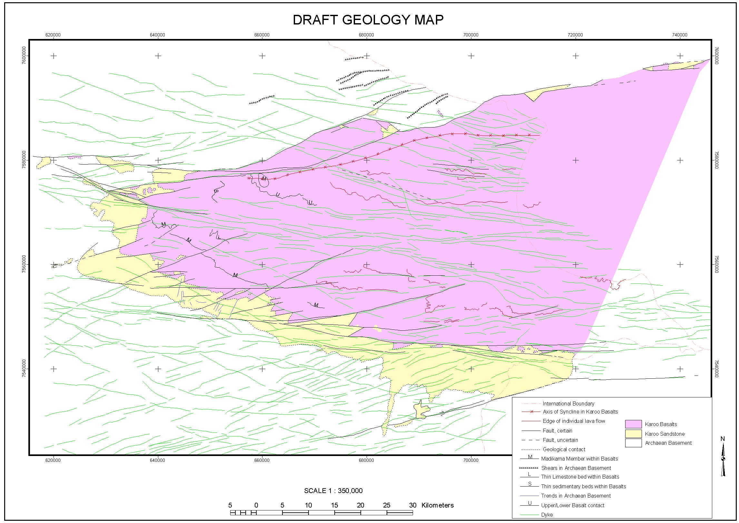
Structural Geology

Slide 47
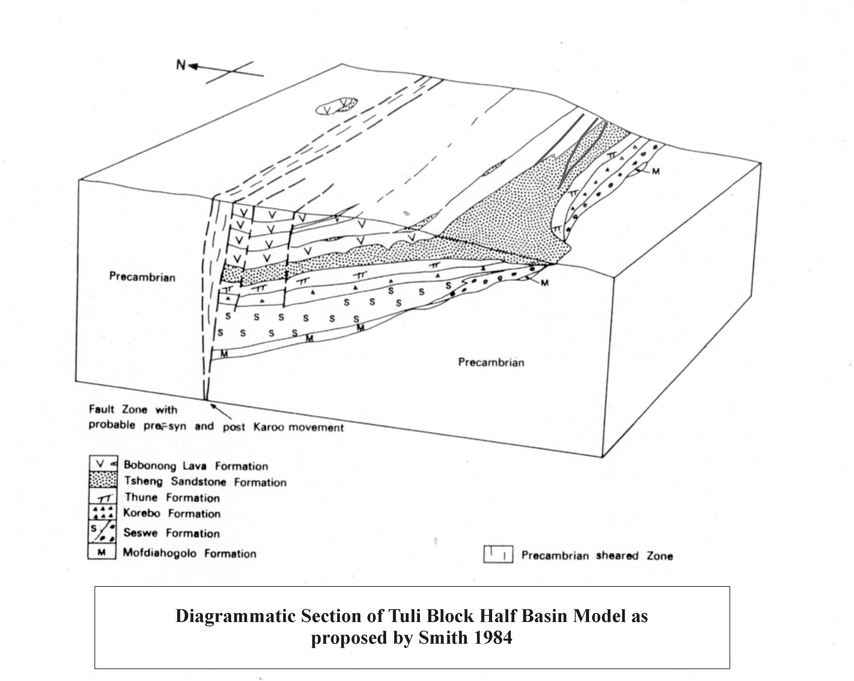

Slide 48
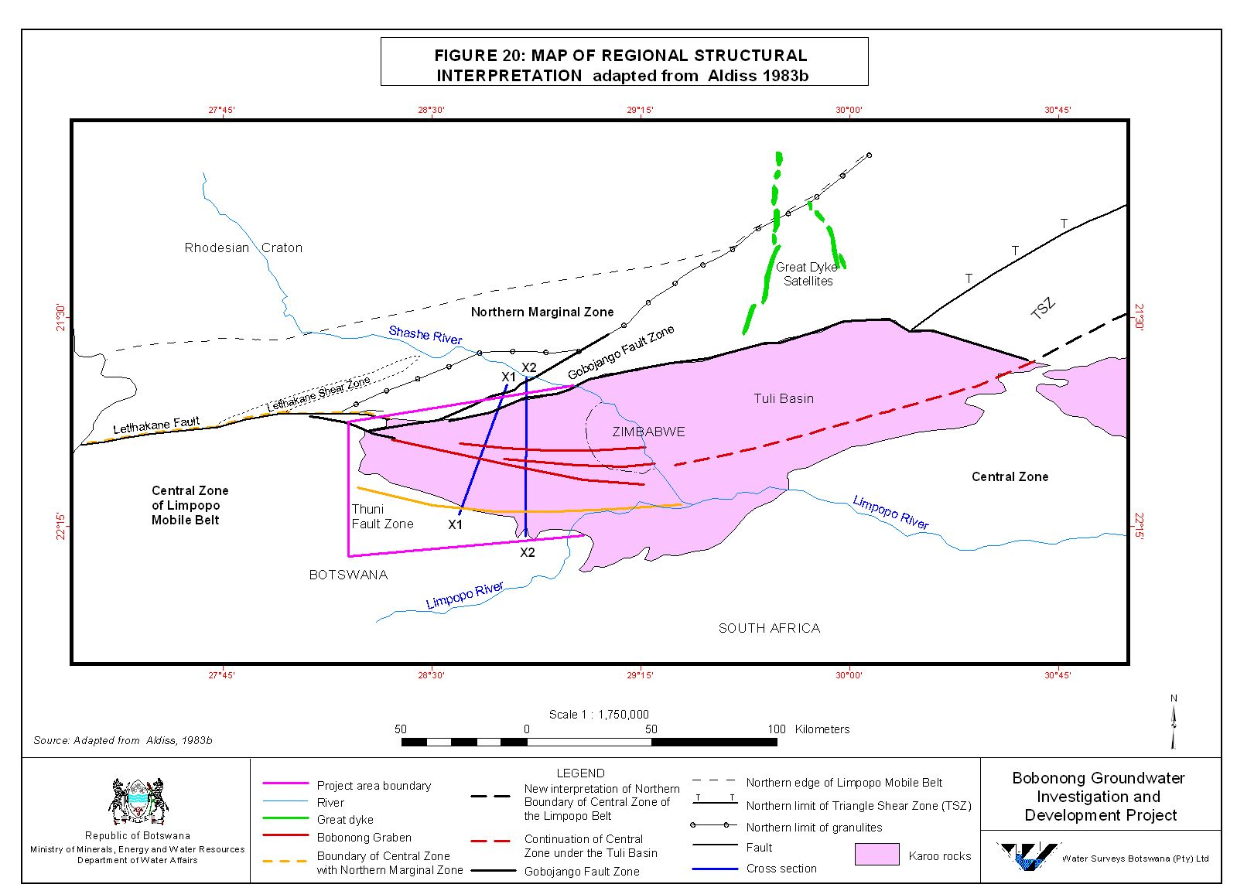

Slide 49
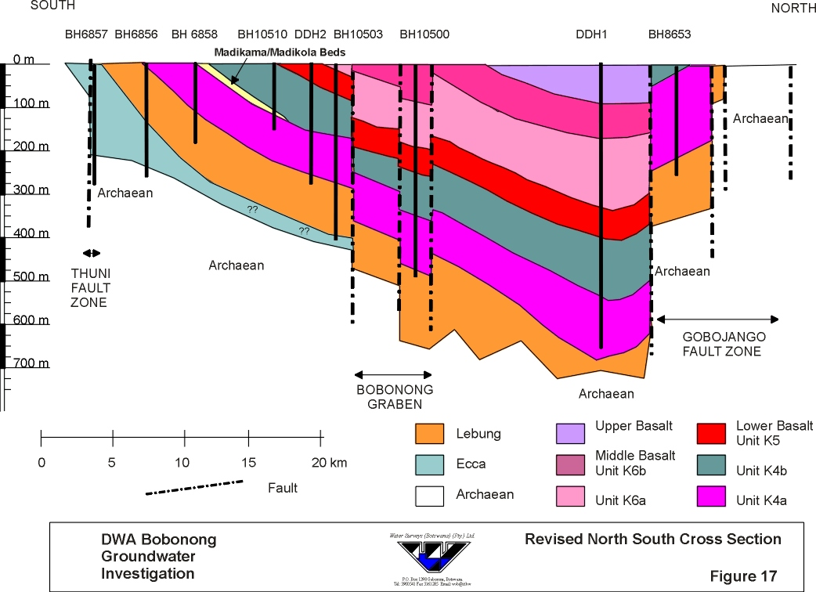
Notes:
Assymetrical synform

Slide 50
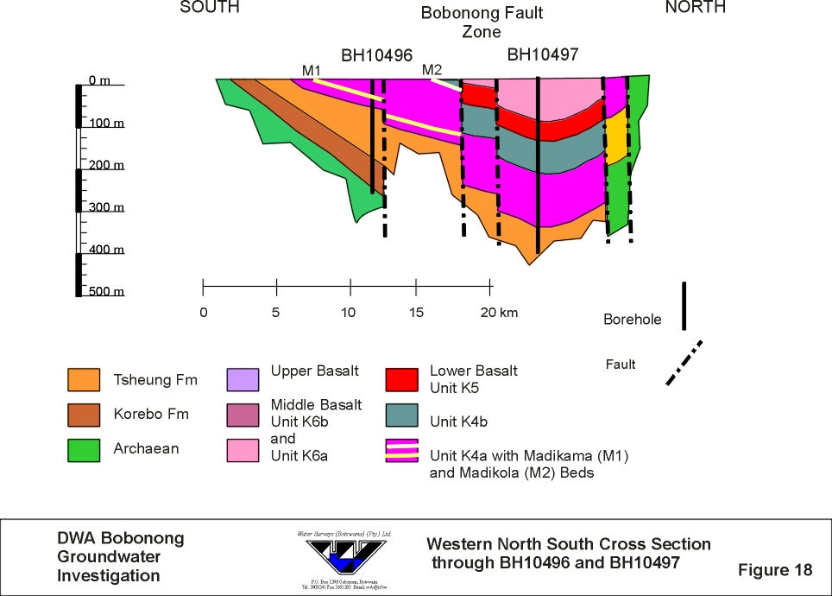

Slide 51
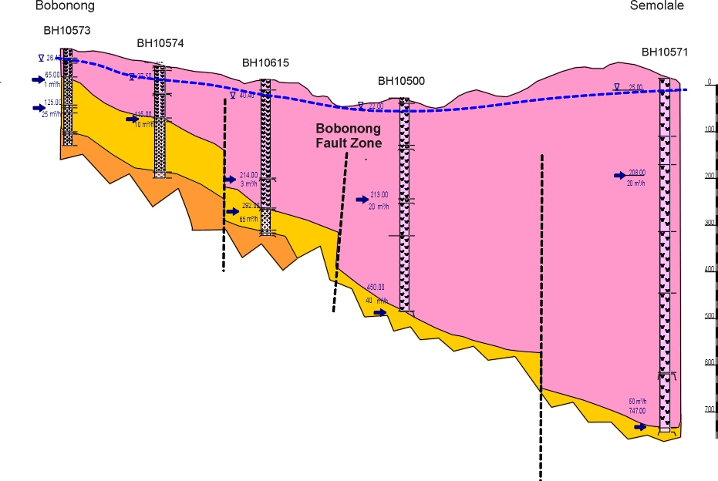

Slide 52
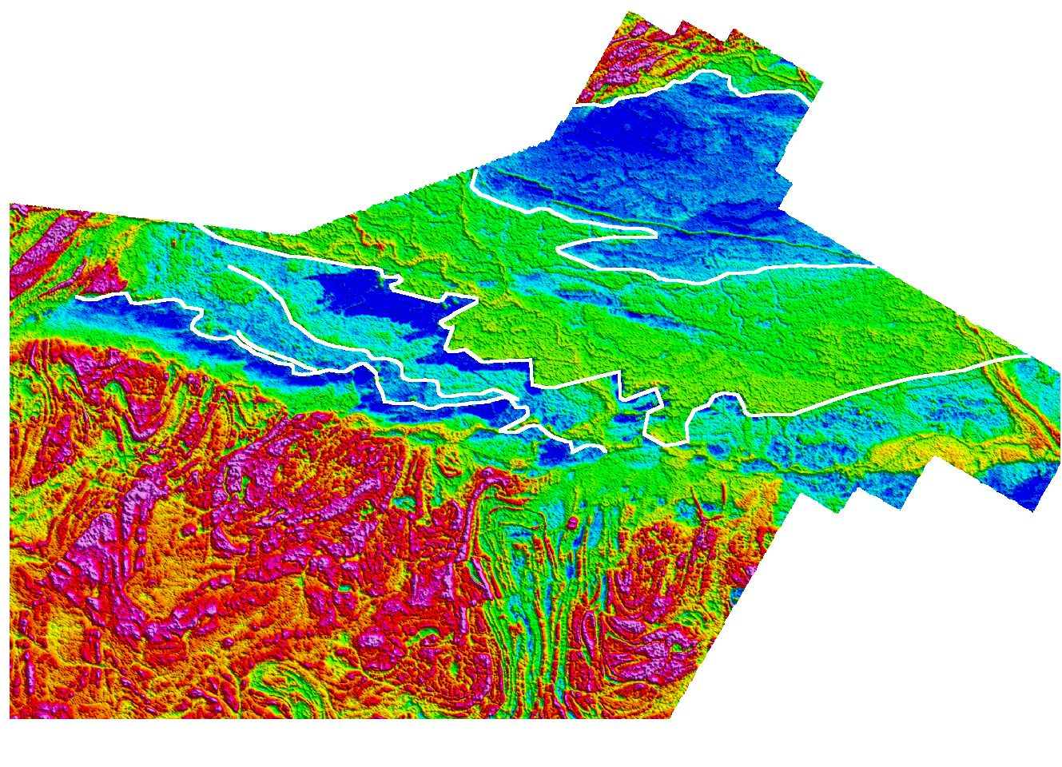
Madikama Beds
Upper Lava Flow Unit
Lower Lava Unit
Middle Lava Flow Unit

Slide 53
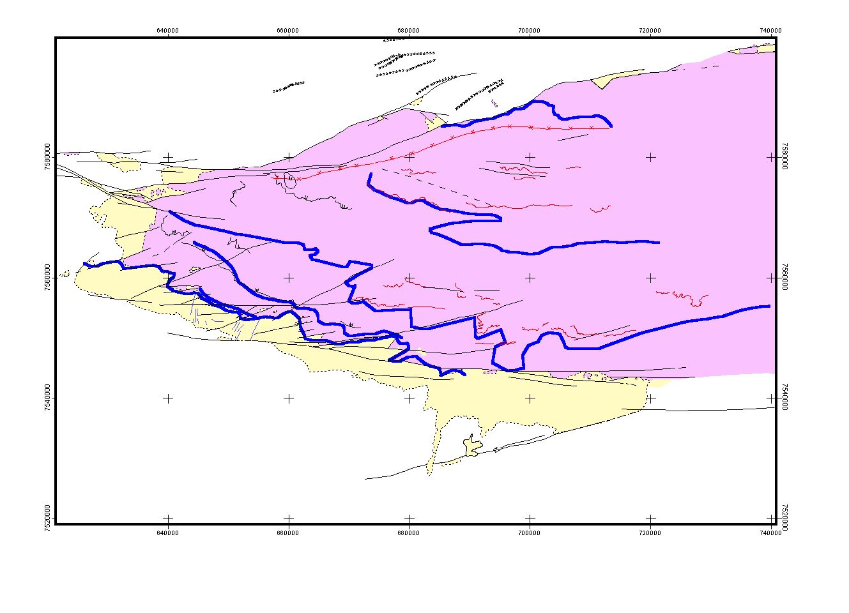
Upper Lava Unit
Middle Lava Unit

Slide 54
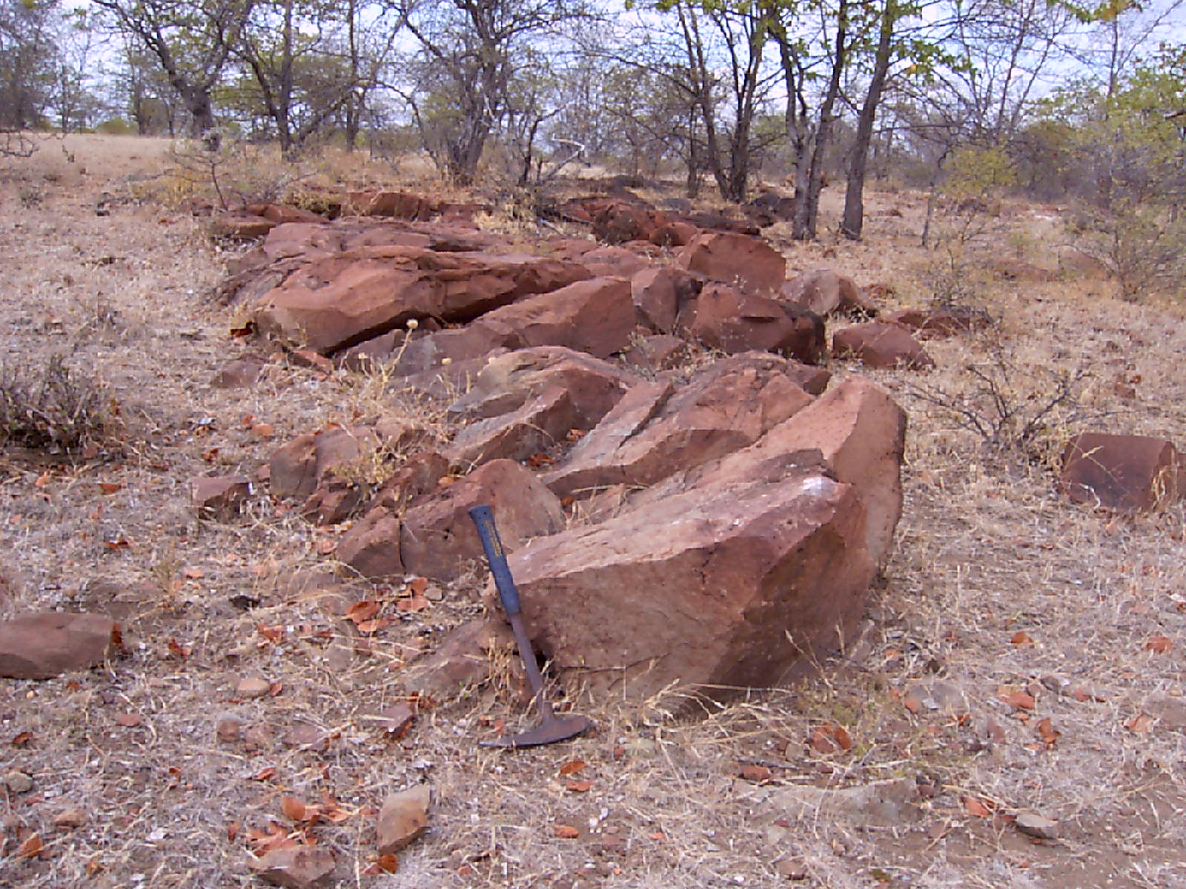

Slide 55
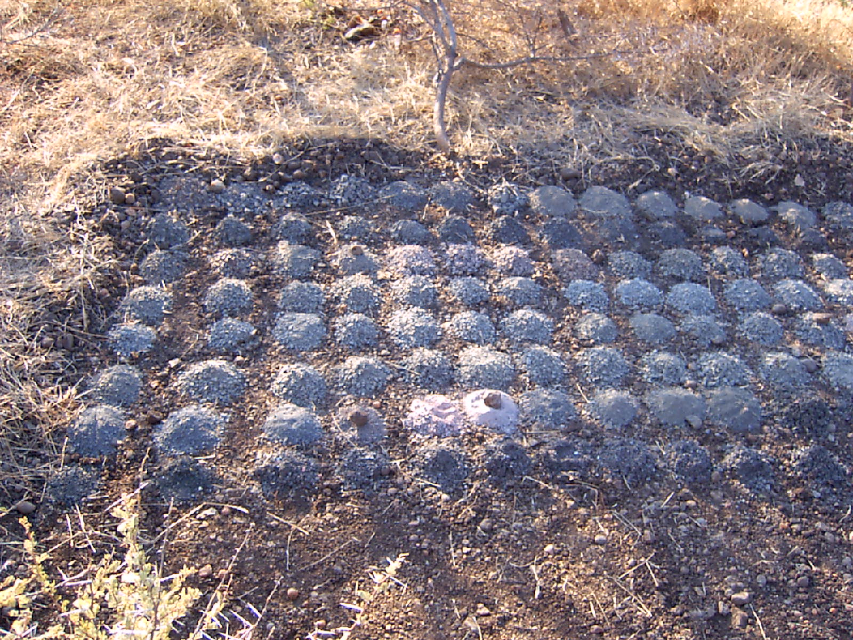

Slide 56
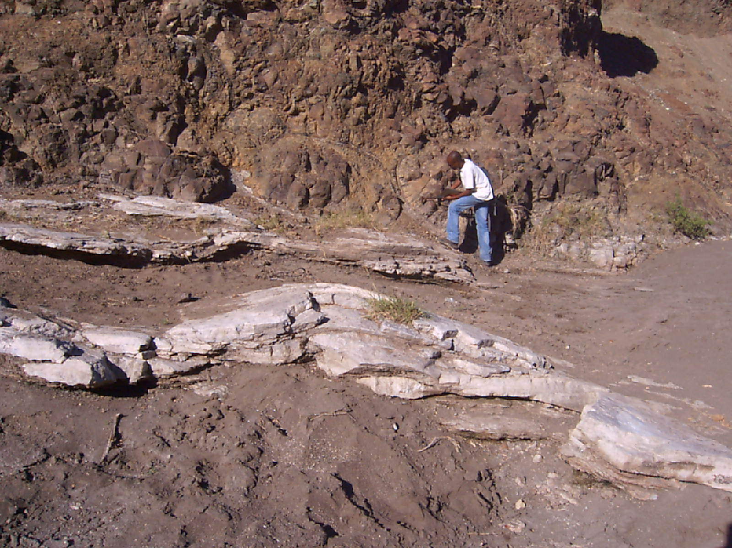

Slide 57
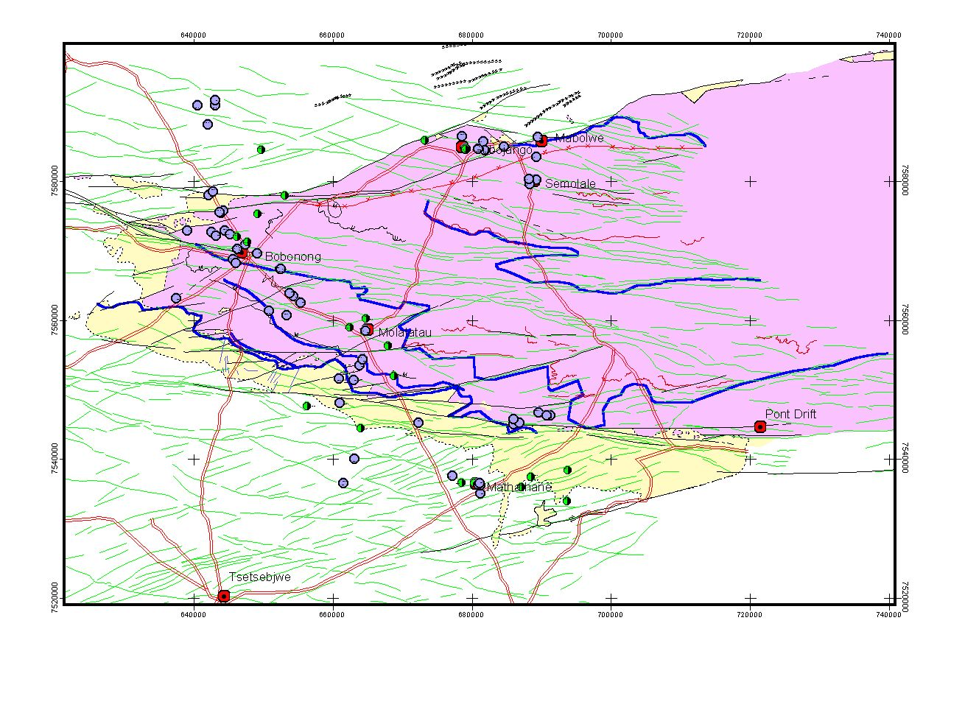

Slide 58
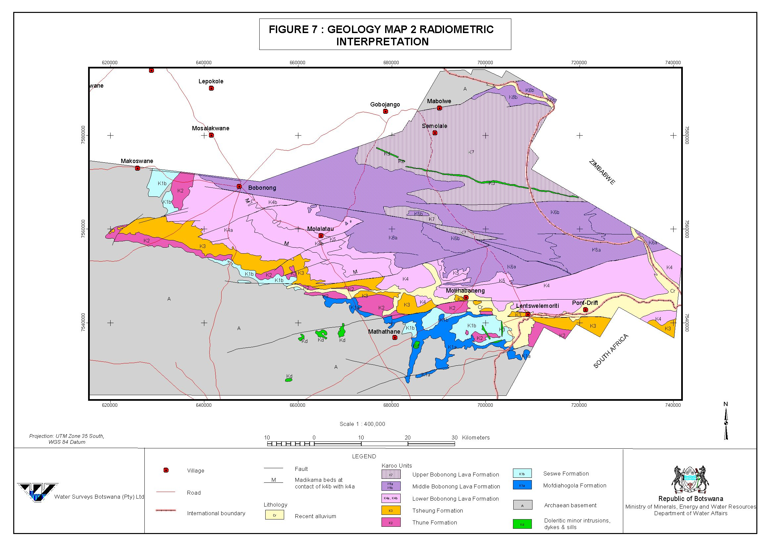

Slide 59
Borehole Siting Surveys
T. Preston

Slide 60
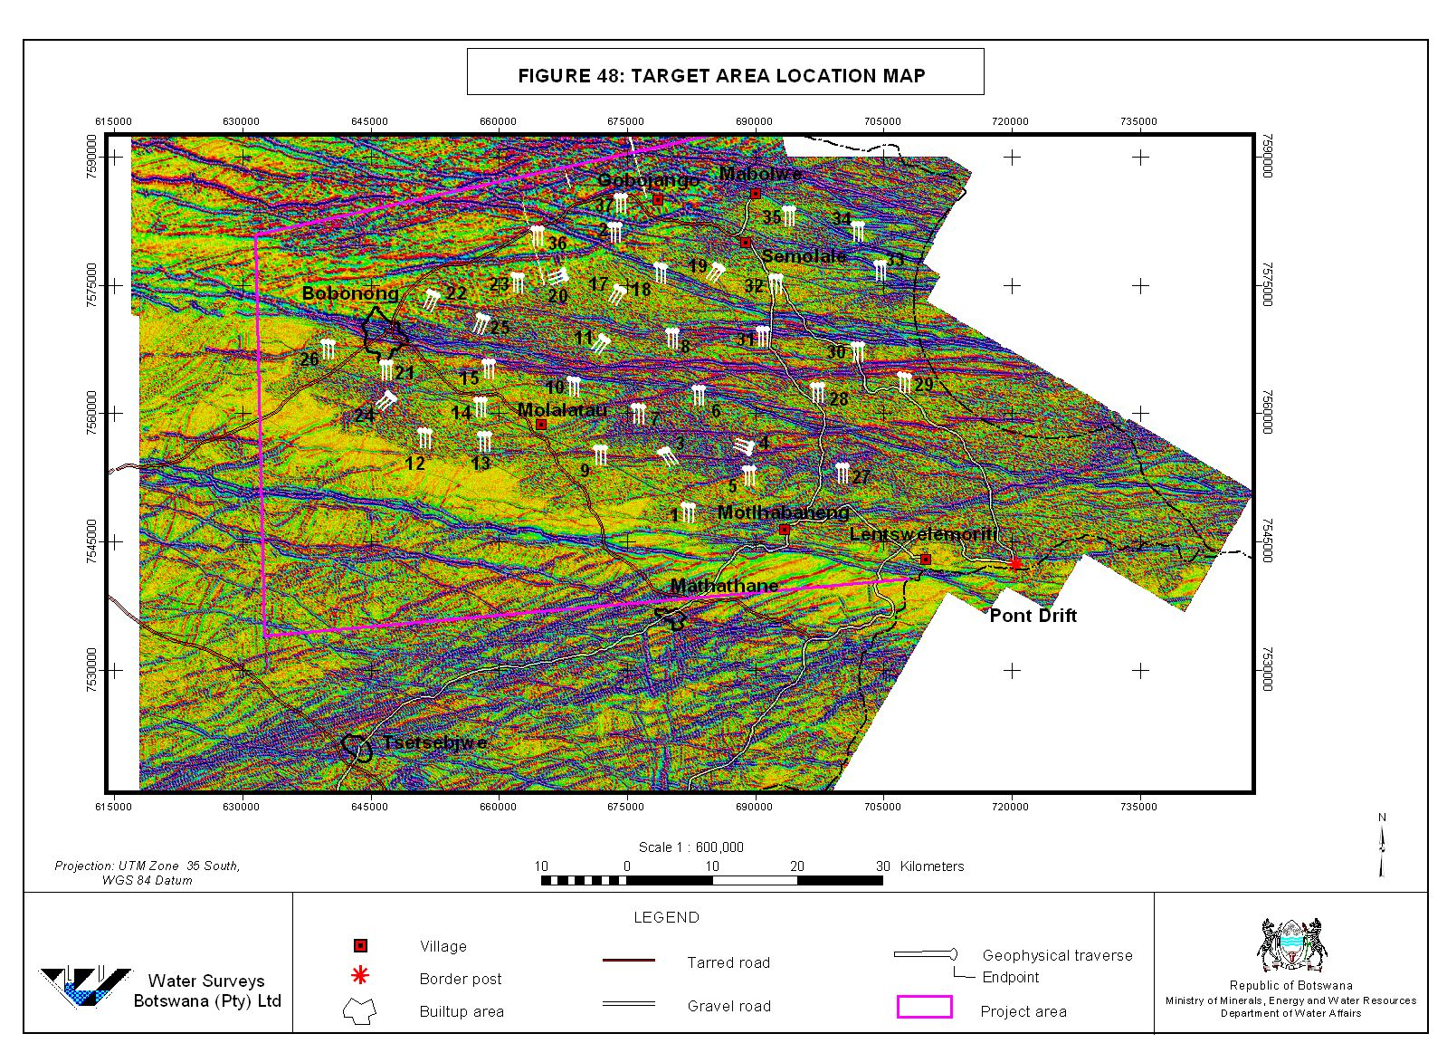

Slide 61
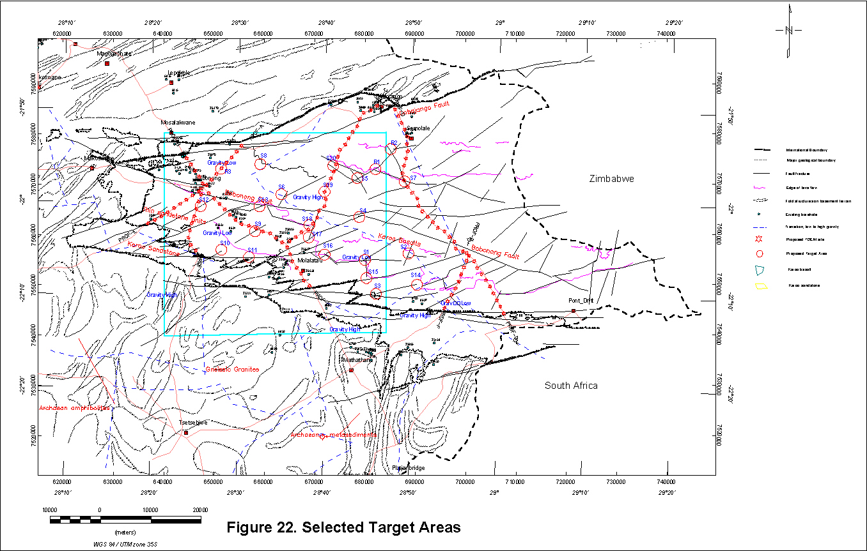

Slide 62
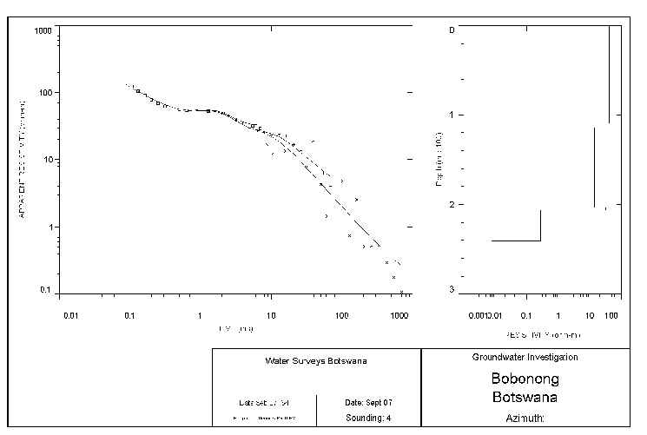

Slide 63
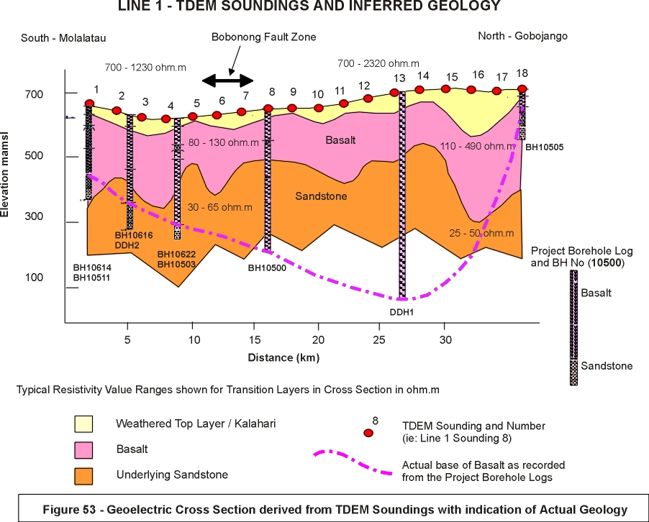

Slide 64
Other Siting Methods Employed
Gym-Sys modelling – not successful as variations in magnetic susceptibility too great
HLEM Profiling – appropriate only on southern edge of basin where basalt was thin elsewhere in thick basalt areas could locate fractures within top basalt layer only
Ground Magnetics – suitable for locating dykes as with Gym-Sys low/high magnetic susceptibility layering of basalt proved problematic
Gravity – showed general direction of thickening of basalt
All methods failed to identify sandstone beneath thick basalt

Slide 65
Drilling & Testing
J. Hiley

Slide 66
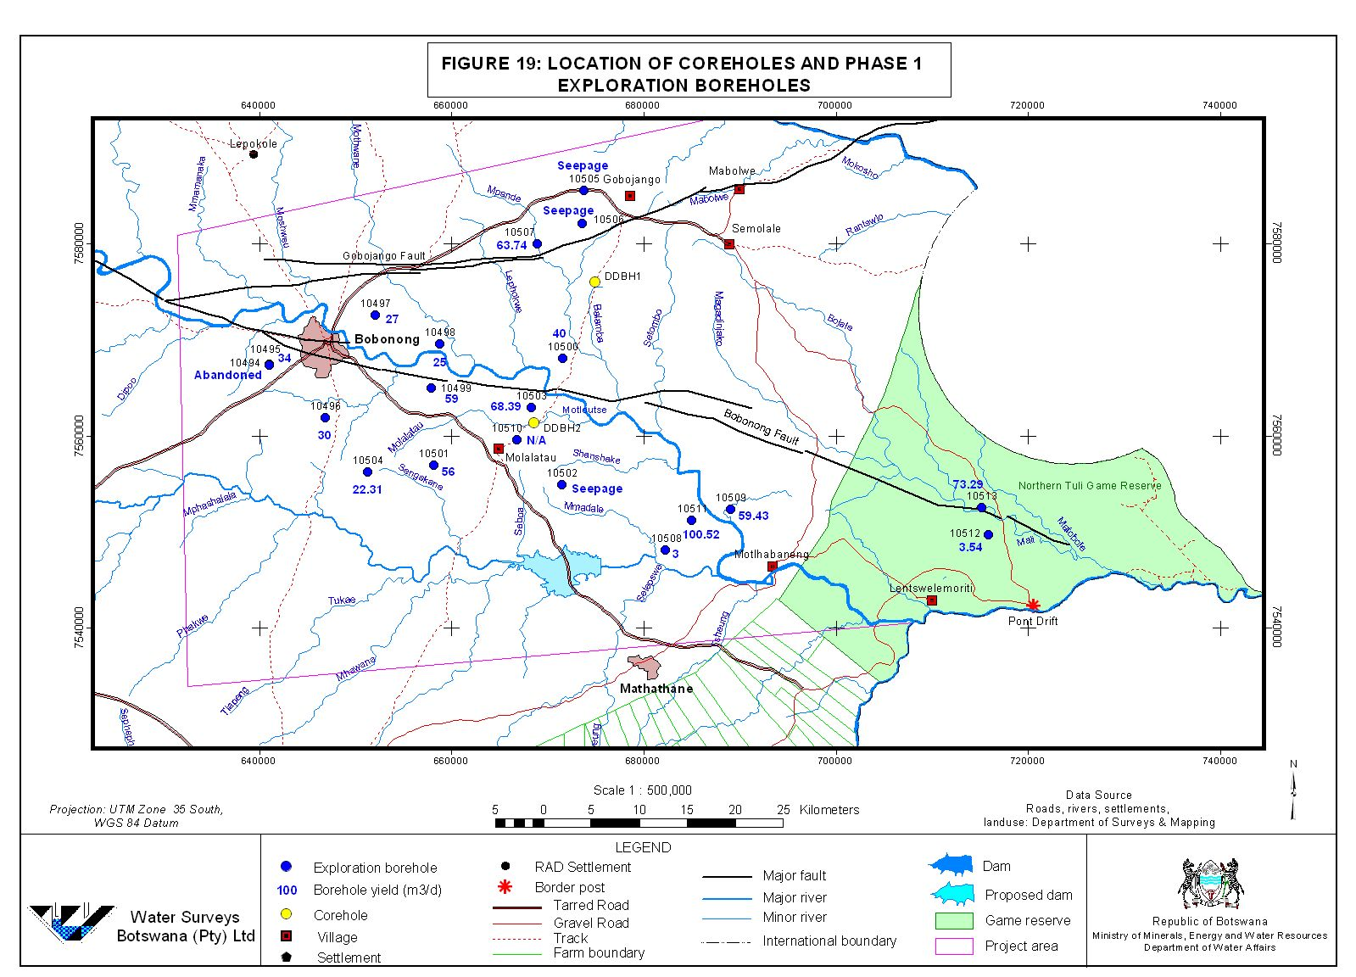

Slide 67

Back pressure surge during drilling

Slide 68

Lack of pressure during drilling

Slide 69

Two Compressors linked in series with Hurricane Booster

Slide 70


Slide 71


Slide 72
Production Borehole Design
All boreholes lined with Hagulit 8” diameter casing & screen.
Full thickness of sandstone screened.

Slide 73


Slide 74


Slide 75
TDS of Exploration and Production Boreholes
(excluding shallow monitoring boreholes)
Deeper Exploration Boreholes

Slide 76
Typical Step Test Pumping Drawdown Curve

Slide 77

Pump Intake 150 mbgl – Static Water Level – 25 mbgl
1st Main Water Strike Recorded during Drilling
Depth to Top of Basalt

Slide 78
Final Recommended Yields from Phase II Drilling

Slide 79
Hydrogeology
J. Hiley

Slide 80


Slide 81
Base of the Basalt

Slide 82
Base of the Basalt + Lineaments

Slide 83
Unit Thickness –
BH10617
Exploration Borehole at Motlhabaneng
Fully Penetrated to Basement - 478 mbgl
Basalt Thickness – 148 m
Tsheung Thickness – 74 m
Thune/Korebo Thickness – 190 m
Seswe Thickness - 66 m

Slide 84


Slide 85
Groundwater Contours

Slide 86


Slide 87
Shashe River Alluvial Aquifer
Two monitoring boreholes were constructed within Shashe River floodplain
Objective – to monitor water levels before & after construction of upstream Dikgatlhong Dam.

Slide 88


Slide 89
Drilling Results
BH’s 10635 & 10638
Water levels 4mbgl
Saturated alluvial sand thickness 12 & 23m
Both boreholes terminated in basalt
Boreholes lined with 165mm diameter Johnson stainless steel screen
Borehole yields 100m3 and 44m3/hr

Slide 90

Shashe River Alluvium

Slide 91

Shashe River Alluvial Borehole CRT Drawdown Curves

Slide 92
Simplistic Resource Estimate
Floodplain area under study equates roughly to 40km2
Using a minimum saturated aquifer thickness of 12m
Equates to a saturated resource of 480Mm3
Using a conservative 10% storage value some 48Mm3/annum of groundwater is available
The resource is fully recharged annually following first flood event.
Only user downstream Messina Mine

Slide 93
Monitoring

Slide 94


Slide 96

Pathlines: 500m³/d scenario

Slide 97
Hydrochemical Monitoring
Needed to monitor possible inflow of poor quality groundwater from north
Identified boreholes 10498; 10500 & 10639

Slide 98
Artificial Recharge

Slide 99


Slide 100
Hydrochemistry
Dr. C. Smith

Slide 101

Durov Plot of all data

Slide 102

Major Ion PCA analysis
Type 7
High TDS (>2000mg/l)
Na₂SO₄ water
SE edge of the project area

Slide 103

Major Ion PCA analysis 10513 and 10512 removed
Types 3 & 4
Mainly along northern edge of the Motloutse River
‘End Waters’
High TDS (up to 2000mg/l)
F >1mg/l, low NO₃
NaCl and NaCa-Cl
Types 1 & 2
Type 6
Type 5
Type 4
Developing water
Ca & Mg low, Na increased
Mixed anions
Mainly south of the Motloutse
Mixed waters
NaCl-SO₄ & locally CaSO4
TDS >1000 North of the river
Type 3
Recharge waters near Gobojango & alluvium
Ca and Mg also NO₃

Slide 104
Major Ion PCA analysis Score >0.1
Mainly found in the SE, south of the Motloutse
Type 1
Type 2
Type 1: Ca, Mg – HCO₃
TDS <1000, nitrate >10
Type 2: similar to Type 1
with higher Na (ca 100mg/l)

Slide 105
Hydrochemical cross-sections

Slide 106
South – North cross-section

Slide 107
West to East cross-section

Slide 108
Magnesium (meq/l)

Slide 109
Sodium (meq/l)

Slide 110
TDS (‘mg/l’)

Slide 111
Occurrence of groundwater types

Slide 113
Groundwater Model
Dr. C. Smith

Slide 114
Modelling Objectives
Incorporate data from the project into a calibrated computer model
Simulate aquifer response to pumping scenarios
Evaluate exploitable resource
Propose a groundwater management scheme

Slide 115
Outline Geology

Slide 116

North to South Cross-Section

Slide 117

Conceptual Model

Slide 118

Modelled recharge/discharge areas

Slide 119

Modelled top of Tsheung

Slide 120
Modelled v Observed heads
K=0.15m/d (T=10m²/d)
S=2.3E-3 (Ss=3E-5 for 75m aquifer)
Sy=0.012

Slide 121

Groundwater Levels (already showing some depletion around existing Bobonong Wellfield Boreholes)

Slide 122

Modelled 10 year drawdown for Bobonong wells

Slide 123
Recharge
Various estimates of recharge in the order of 10,000 to 15,000m³/day
Balanced by flow through the basalt and eastern boundary
Estimated recharge 2 to 8mm/year around the edge of the aquifer
Basalt discharge around <1mm/year

Slide 124
Modelled groundwater levels (A)

Slide 125
Modelled groundwater levels (B)

Slide 126
Modelled drawdown: 16 wells 300m³/d 20 years

Slide 127

Modelled Drawdown in 2030 abstracting 7500 m³/day
Note - Maximum Drawdown only around 35 m

Slide 128
Modelled drawdown: 16 wells 500m³/d 20 years

Slide 129
Pathlines: 500m³/d scenario

Slide 130


Slide 131
Conclusions & Recommendations
T. Preston

Slide 132
Major Conclusions
A new Geology map has been generated
Radiometrics allowed mapping of Madikama Beds
The half graben model is replaced by an assymetric synform
Major structures are the Bobonong graben and the Gobojango and Thuni faults
A maximum thickness of 752m of basalt was recorded
Areas of unconfined Lebung & Ecca are important recharge zones
Recharge has been estimated at 1mm which equates to 10,000m3/day over the recharge zone
Abstraction (water demand 6000m3/day) is sustainable
Artesian groundwater conditions have been recorded with yields >100m3/hr
The groundwater quality of the Tsheung Sandstone is good within BOBS guidelines

Slide 133
Groundwater Resource
Properly managed (10 hour pumping 500m3/day) the wellfield boreholes can supply the regions water demand to 2031
Used conjunctively with Thuni Dam the aquifer, with boreholes operating say 6months/year, could supply up to 2050 & beyond
High scenario abstraction equates to annual recharge rate 3.65Mm3/yr

Slide 134
Groundwater Model
The model should be updated two years after pumping commences. This will give more certainty to the storage value used in the first generation model.
Monthly measurement of the established groundwater monitoring network should be maintained in the interim

Slide 135


Slide 136
Thuni Dam Pipeline
Ministry of Agriculture still seeking PPP to fund pipeline. This currently excludes any linkage to wellfield supplies.
Thus pipeline design not finalised.
Proposed pipeline from feasibility study terminates at Mathatane & does not link to Tsetsebjwe or Motlhabaneng/Lentswemoriti.
Existing pipeline from Mathatane to Tsetsebjwe is too small to carry any additional flow.

Slide 137
BH No.
Location
Supplying
Current
Recommended
hours/day
Comment
8554
Bobonong wellfield
Bobonong
Not in use water level reaches intake minutes after pumping commences
Borehole should be retested
8634
Bobonong wellfield
Bobonong
1600
(66m³/hr )
660m³/day
24
Reduce to 10 hour day pumping
8635
Bobonong wellfield
Bobonong
1200
(50)
500
24
Reduce to 10 hour day pumping
2BB
Bobonong wellfield
Bobonong
To be equipped by District Water Unit yield unknown BH was originally artesian
Borehole should be tested
New Project Production Boreholes
10568
West of Bobonong
Bobonong
(30)
300
Recommend 10 hour/day pumping
10569
West of wellfield
Bobonong
(64)
640
Recommend 10 hour/day pumping
10572
NW of wellfield
Bobonong
(68)
680
Recommend 10 hour/day pumping
10573
South of wellfield
Bobonong
(30)
300
Recommend 10 hour/day pumping
10575
SE of wellfield
Bobonong
(96)
960
Recommend 10 hour/day pumping
10615
SE of wellfield
Bobonong
(70)
700
Recommend 10 hour/day pumping
10619
SE of wellfield
Bobonong
(100)
1000
Recommend 10 hour/day pumping
Projected 2021 Cluster 3 Water Demand 3m³/day
Existing Supply Total
1160m³/day
New Production Borehole Supply Total
2880m³/day
Total Potential Supply
5740m³/day

Slide 138
Remedial Works
A water audit should be carried out to identify and quantify pumping rates, delivered volumes, calculate losses etc.
The telemetric system at Bobonong needs to be repaired +/or upgraded.
Water levels need to be monitored in Bobonong & Motlhabaneng wellfield production boreholes.
All production boreholes should be operated on a 10 hour day pumping schedule.
New project boreholes need to be equipped as soon as possible to supply Bobonong, Mathathane and Tsetsebjwe. Failure to expedite this will result in a water supply crisis i.e. some of the existing production boreholes will dry up.

